Slide 1

Operator dan Struktur Kontrol pada PHP

Slide 2
Operator
Digunakan untuk melakukan operasi pada variabel dan nilai:
Arithmetic operators
Assignment operators
Comparison operators
Increment/Decrement operators
Logical operators
String operators
Array operators
Conditional assignment operators

Slide 3
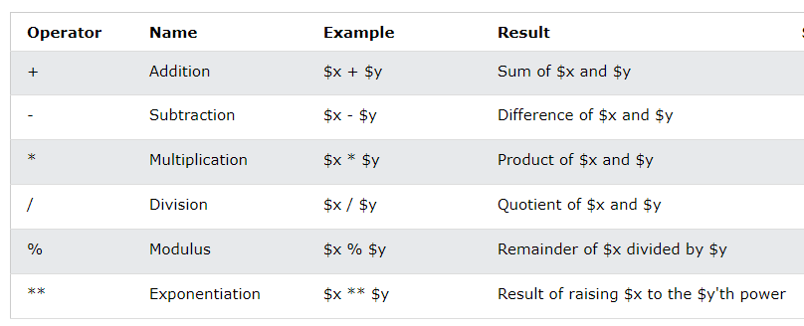
Operator Aritmatika
<!DOCTYPE html>
<html>
<body>
<?php
$x = 10;
$y = 6;
echo $x * $y;
?>
</body>
</html>

Slide 4
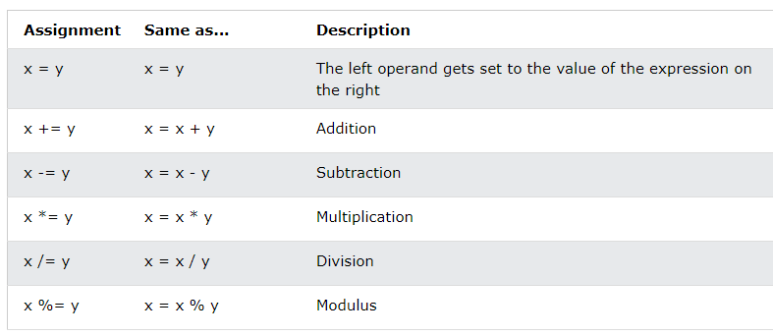
Operator Assignment
<!DOCTYPE html>
<html>
<body>
<?php
$x = 20;
$x += 100; //$x=$x+100;
echo $x;
?>
</body>
</html>

Slide 5
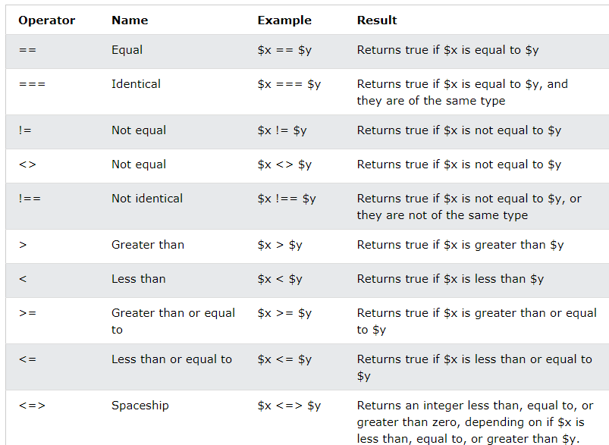
Operator Komparasi
<!DOCTYPE html>
<html>
<body>
<?php
$x = 100;
$y = "100";
var_dump($x == $y); // returns true because values are equal
?>
</body>
</html>

Slide 6
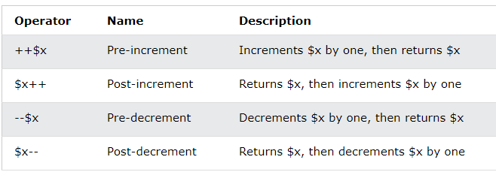
Operator Increment / Decrement
<!DOCTYPE html>
<html>
<body>
<?php
$x = 10;
echo ++$x;
?>
</body>
</html>

Slide 7
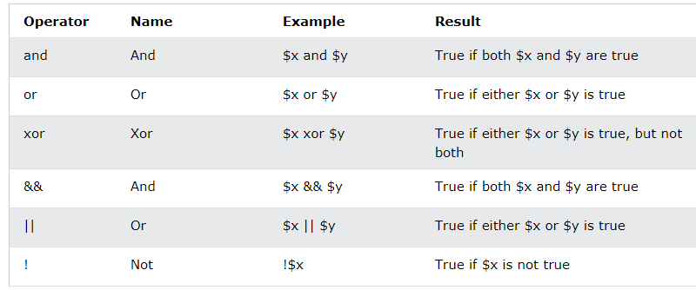
Operator Logical
<!DOCTYPE html>
<html>
<body>
<?php
$x = 100;
$y = 50;
if ($x == 100 and $y == 50) {
echo "Hello world!";
}
?>
</body>
</html>

Slide 8
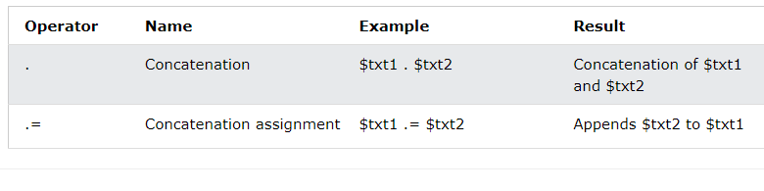
Operator String
<!DOCTYPE html>
<html>
<body>
<?php
$txt1 = "Hello";
$txt2 = " world!";
$txt1 .= $txt2; // $txt1=$txt1.$txt2
echo $txt1;
?>
</body>
</html>

Slide 9
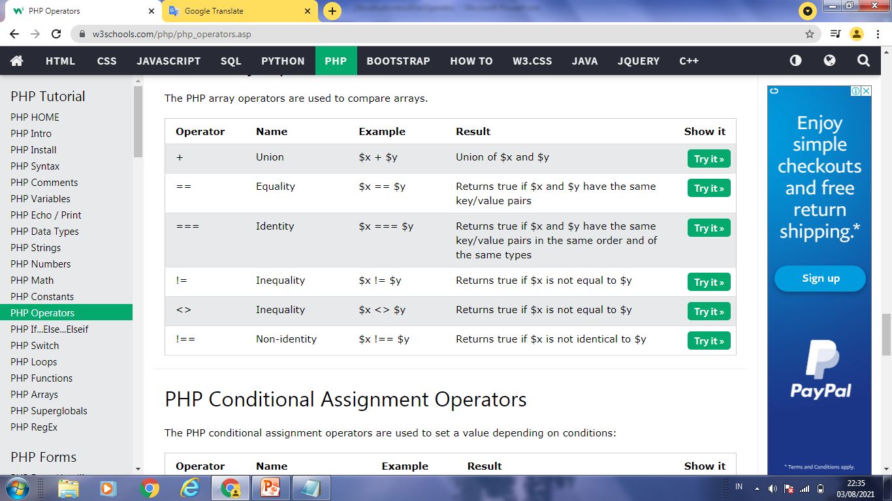
Operator pd Array
<!DOCTYPE html>
<html>
<body>
<?php
$x = array("a" => "red", "b" => "green");
$y = array("c" => "blue", "d" => "yellow");
print_r($x + $y); // union of $x and $y
?>
</body>
</html>

Slide 10
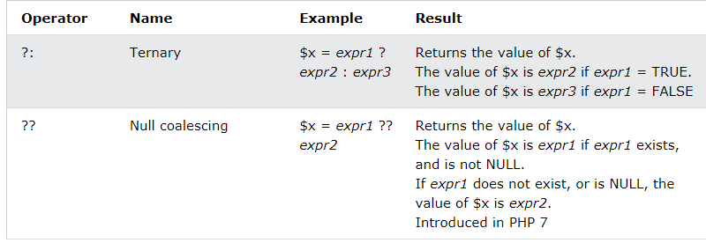
Operator Assignment Kondisional
<!DOCTYPE html>
<html>
<body>
<?php
// if empty($user) = TRUE, set $status = "anonymous"
echo $status = (empty($user)) ? "anonymous" : "logged in";
echo("<br>");
$user = "John Doe";
// if empty($user) = FALSE, set $status = "logged in"
echo $status = (empty($user)) ? "anonymous" : "logged in";
echo $user = $_GET["user"] ?? "anonymous";
echo("<br>");
?>
</body>
</html>

Slide 11
Operator Assignment Kondisional
<!DOCTYPE html>
<html>
<body>
<?php
// if empty($user) = TRUE, set $status = "anonymous"
echo $status = (empty($user)) ? "anonymous" : "logged in";
echo("<br>");
$user = "John Doe";
// if empty($user) = FALSE, set $status = "logged in"
echo $status = (empty($user)) ? "anonymous" : "logged in";
echo $user = $_GET["user"] ?? "anonymous";
echo("<br>");
?>
</body>
</html>

Slide 12
Struktur Kontrol
Kondisional ( IF, Swirch)
Loop

Slide 13
Kondisional [If ; If Else ; If elseif else;]
<?php
$t = date("H");
if ($t < "20") {
echo "Have a good day!";
}
?>
<!DOCTYPE html>
<html>
<body>
<?php
$t = date("H");
echo "<p>The hour (of the server) is " . $t;
echo ", and will give the following message:</p>";
if ($t < "10") {
echo "Have a good morning!";
} elseif ($t < "20") {
echo "Have a good day!";
} else {
echo "Have a good night!";
}
?>
</body>
</html>
<?php
$t = date("H");
if ($t < "20") {
echo "Have a good day!";
} else {
echo "Have a good night!";
}
?>

Slide 14
Kondisional - Switch
<!DOCTYPE html>
<html>
<body>
<?php
$favcolor = "red";
switch ($favcolor) {
case "red":
echo "Your favorite color is red!";
break;
case "blue":
echo "Your favorite color is blue!";
break;
case "green":
echo "Your favorite color is green!";
break;
default:
echo "Your favorite color is neither red, blue, nor green!";
}
?>
</body>
</html>

Slide 15
Loop
While
do while
For
Foreach
Break
Continue

Slide 16
While
<!DOCTYPE html>
<html>
<body>
<?php
$x = 1;
while($x <= 5) {
echo "The number is: $x <br>";
$x++;
}
?>
</body>
</html>

Slide 17
do while
<?php
$x = 1;
do {
echo "The number is: $x <br>";
$x++;
} while ($x <= 5);
?>

Slide 18
For
<?php
for ($x = 0; $x <= 10; $x++) {
echo "The number is: $x <br>";
}
?>

Slide 19
For each
<!DOCTYPE html>
<html>
<body>
<?php
$colors = array("red", "green", "blue", "yellow");
foreach ($colors as $value) {
echo "$value <br>";
}
$age = array("Peter"=>"35", "Ben"=>"37", "Joe"=>"43");
foreach($age as $x => $val) {
echo "$x = $val<br>";
}
?>
</body>
</html>

Slide 20
Break,Continue
<!DOCTYPE html>
<html>
<body>
<?php
for ($x = 0; $x < 10; $x++) {
if ($x == 4) {
break;
}
echo "The number is: $x <br>";
}
?>
</body>
</html>
<!DOCTYPE html>
<html>
<body>
<?php
for ($x = 0; $x < 10; $x++) {
if ($x == 4) {
continue;
}
echo "The number is: $x <br>";
}
?>
</body>
</html>

